Slide 1
What is Computing?
Mack 2021

Slide 2
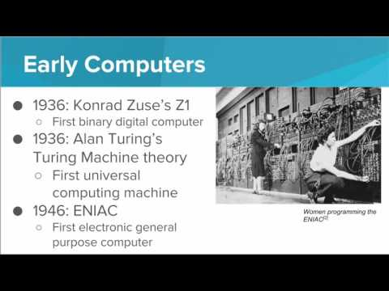
In this video, we'll go through a brief overview of the history of the computer, see how computers have developed and been used throughout history, and see what computers are being used for today.

Slide 3
Which of the following statements is true?
I. Computers have only been around since the 1940’s
II. One reason computers were first developed was to do mathematical computations faster
III. Some modern computers include laptops, cell phones, and tablets
IV. Computers are able to perform tasks by using logic
Notes:
🍐 This is a Pear Deck Multiple Choice Slide. Your current options are: A: I, III, B: II, III, IV, C: III, IV, D: I, II, III, IV,
🍐 To edit the type of question or choices, go back to the "Ask Students a Question" in the Pear Deck sidebar.
B

Slide 4
Which of the following statements is the simplest and most accurate definition of a computer?
Notes:
🍐 This is a Pear Deck Multiple Choice Slide. Your current options are: A: A computer is a machine that is able to solve any problem., B: A computer is a machine that can be programmed., C: A computer is something that performs calculations by following and executing specific instructions to solve a problem., D: A computer is something that runs applications and accesses the internet.,
🍐 To edit the type of question or choices, go back to the "Ask Students a Question" in the Pear Deck sidebar.
C

Slide 5
Which of the following choices correctly orders the early types of computers from earliest to most recent?
Notes:
🍐 This is a Pear Deck Multiple Choice Slide. Your current options are: A: Abacus, Analytical Engine, ENIAC, IBM Laptop, B: Analytical Engine, Abacus, IBM Laptop, ENIAC, C: ENIAC, Analytical Engine, Abacus, IBM Laptop, D: IBM Laptop, ENIAC, Analytical Engine, Abacus,
🍐 To edit the type of question or choices, go back to the "Ask Students a Question" in the Pear Deck sidebar.
A

Slide 6
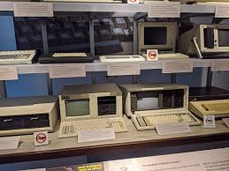
Mission: Who invented the computer?
Your Mission: Over the next few activities, you will explore the question, Who invented the computer?
Use the following questions to guide your thinking:
What did the word computer mean to this person?
What is the main contribution of the person or group of people?
Notes:
In the following exhibits, you will investigate a specific person or group of people who played a role in the development of the computer. Your job is to collect evidence as you go to determine who you consider to the main inventor

Slide 7
Exhibit A: Charles Babbage
Directions: Explore this virtual exhibit about Charles Babbage and the Analytical Engine. As you read through the page, make sure to take notes in the Evidence Collection activity.
Guiding Questions:
What did the word computer mean to Babbage?
What is Babbage’s main contribution to the development of the computer?
https://www.computerhistory.org/revolution/calculators/1/51

Slide 8
Exhibit B: Ada Lovelace
Directions: You learned a little bit about Ada Lovelace in your investigation of Charles Babbage. Watch this video to learn more about Ada’s contributions to Babbage’s innovations. Make sure to take notes in the Evidence Collection activity.
Guiding Questions:
What did the word computer mean to Lovelace?
What is Lovelace’s main contribution to the development of the computer?
https://youtu.be/uBbVbqRvqTM

Slide 9
Exhibit C: Alan Turing
Directions: Watch this video to learn about Alan Turing and his contribution to the development of the computer. As you watch, make sure to take notes in the Evidence Collection activity.
Guiding Questions:
What did the word computer mean to Turing?
What is Turing’s main contribution to the development of the computer?
https://youtu.be/MidJR581irA

Slide 10
Exhibit D: Mauchly and Eckert
Directions: Explore this virtual exhibit about ENIAC. Then, watch the video in the section titled J. Presper Eckert: Little Pink Lights to learn more about what ENIAC was and the impact it had on the development of the computer.
Guiding Questions:
What did the word computer mean to Mauchly and Eckert?
What are Mauchly and Eckert’s main contribution to the development of the computer?
https://www.computerhistory.org/revolution/birth-of-the-computer/4/80

Slide 11
Exhibit E: ENIAC Programmers
Directions: You learned a little bit about ENIAC in your investigation of Mauchly and Eckert. Watch this video to learn more about the people in charge of programming ENIAC. Make sure to take notes in the Evidence Collection activity.
Guiding Questions:
What did the word computer mean to the ENIAC programmers?
What is the ENIAC programmer’s main contribution to the development of the computer?
https://youtu.be/eE69LKO4dCQ

Slide 12
Exhibit F: Grace Hopper
Directions: Explore this virtual exhibit to learn more about Grace Hopper and her contribution to programming languages. You will need to scroll down to about the middle of the exhibit to get to the section dedicated to Hopper. As you read through the page, make sure to take notes in the Evidence Collection activity.
Guiding Questions:
What did the word computer mean to Hopper?
What is Hopper’s main contribution to the development of the computer?
https://www.computerhistory.org/revolution/early-computer-companies/5/117

Slide 13
Exhibit G: Mark Dean
Directions: Read the article to learn about Mark Dean and his contribution to the development of the computer. As you read through the page, make sure to take notes in the Evidence Collection activity.
Guiding Questions:
What does the word computer mean to Dean?
What is Dean’s main contribution to the development of the computer?
https://docs.google.com/document/d/1RHXsZTJ6Ny7RPBE3RtyPuB89QLiokS7ccpBHEdt9j0c/edit?usp=sharing

Slide 14
Bonus Exhibit: Computer Inventors
Directions: Look closely at the image that is displayed when you search “Computer Inventors” in Google’s search engine. Compare this picture to the people you learned about over the course of this lesson.
Answer the following questions in your Evidence Collection activity.
Who is missing from this picture?
What questions do you have about this image?
Why do you think some are included while others are not?

Slide 15
Bonus Exhibit: Computer Inventors
Extension: You might notice that some of these men were not part of this lesson. Many men and women played a role in the development of the computer - so many that we weren’t able to fit all of them in! If you want to learn about some of the people in this image that we didn’t get to, click on their links below:
John Atanasoff
Konrad Zuse
Douglas Engelbart

Slide 16
Culminating Activity
You have completed an extensive investigation of the question Who invented the computer? You have gathered sufficient evidence, and the moment has come to report your findings!
Step 1: Write a one sentence summary of your conclusion to the question Who is the inventor of the computer?
Step 2: Choose one of the following methods as evidence to support your claim:
Paragraph: In a minimum of 5 complete sentences, provide specific evidence from a variety of sources.
Timeline: Create a timeline of the development of the computer. Your timeline should highlight the impact of your chosen innovator.
Concept Map: Create a bubble map that visually shows the relationships between the different computer innovations. Your concept map should highlight the impact of your chosen innovator.
If you choose a timeline or a concept map, upload a picture of your diagram and include the link in this assignment.

